Slide 1












Hello, PealStudio
Let’s explore!
PealOS now in beta!
You can access OS just joining our chanel!
OTA deliver!
Install updates without reboot!
30°

Slide 2
Hello, PealStudio
Let’s explore!
PealOS now in beta!
You can access OS just joining our chanel!
OTA deliver!
Install updates without reboot!
30°

Slide 3
Hello, PealStudio
Let’s explore!
PealOS now in beta!
You can access OS just joining our chanel!
OTA deliver!
Install updates without reboot!
30°

Slide 4
Hello, PealStudio
Let’s explore!
PealOS now in beta!
You can access OS just joining our chanel!
OTA deliver!
Install updates without reboot!
30°

Slide 5





Login
Hello, PealStudio
Let’s explore!
PealOS now in beta!
You can access OS just joining our chanel!
OTA deliver!
Install updates without reboot!
30°

Slide 6
Hello, PealStudio
Let’s explore!
PealOS now in beta!
You can access OS just joining our chanel!
OTA deliver!
Install updates without reboot!
30°

Slide 7

Hello, PealStudio
Let’s explore!
PealOS now in beta!
You can access OS just joining our chanel!
OTA deliver!
Install updates without reboot!
30°

Slide 8










Hello, PealStudio
Let’s explore!
Dota 2 is ready,
gotov popku pupsik

Slide 9

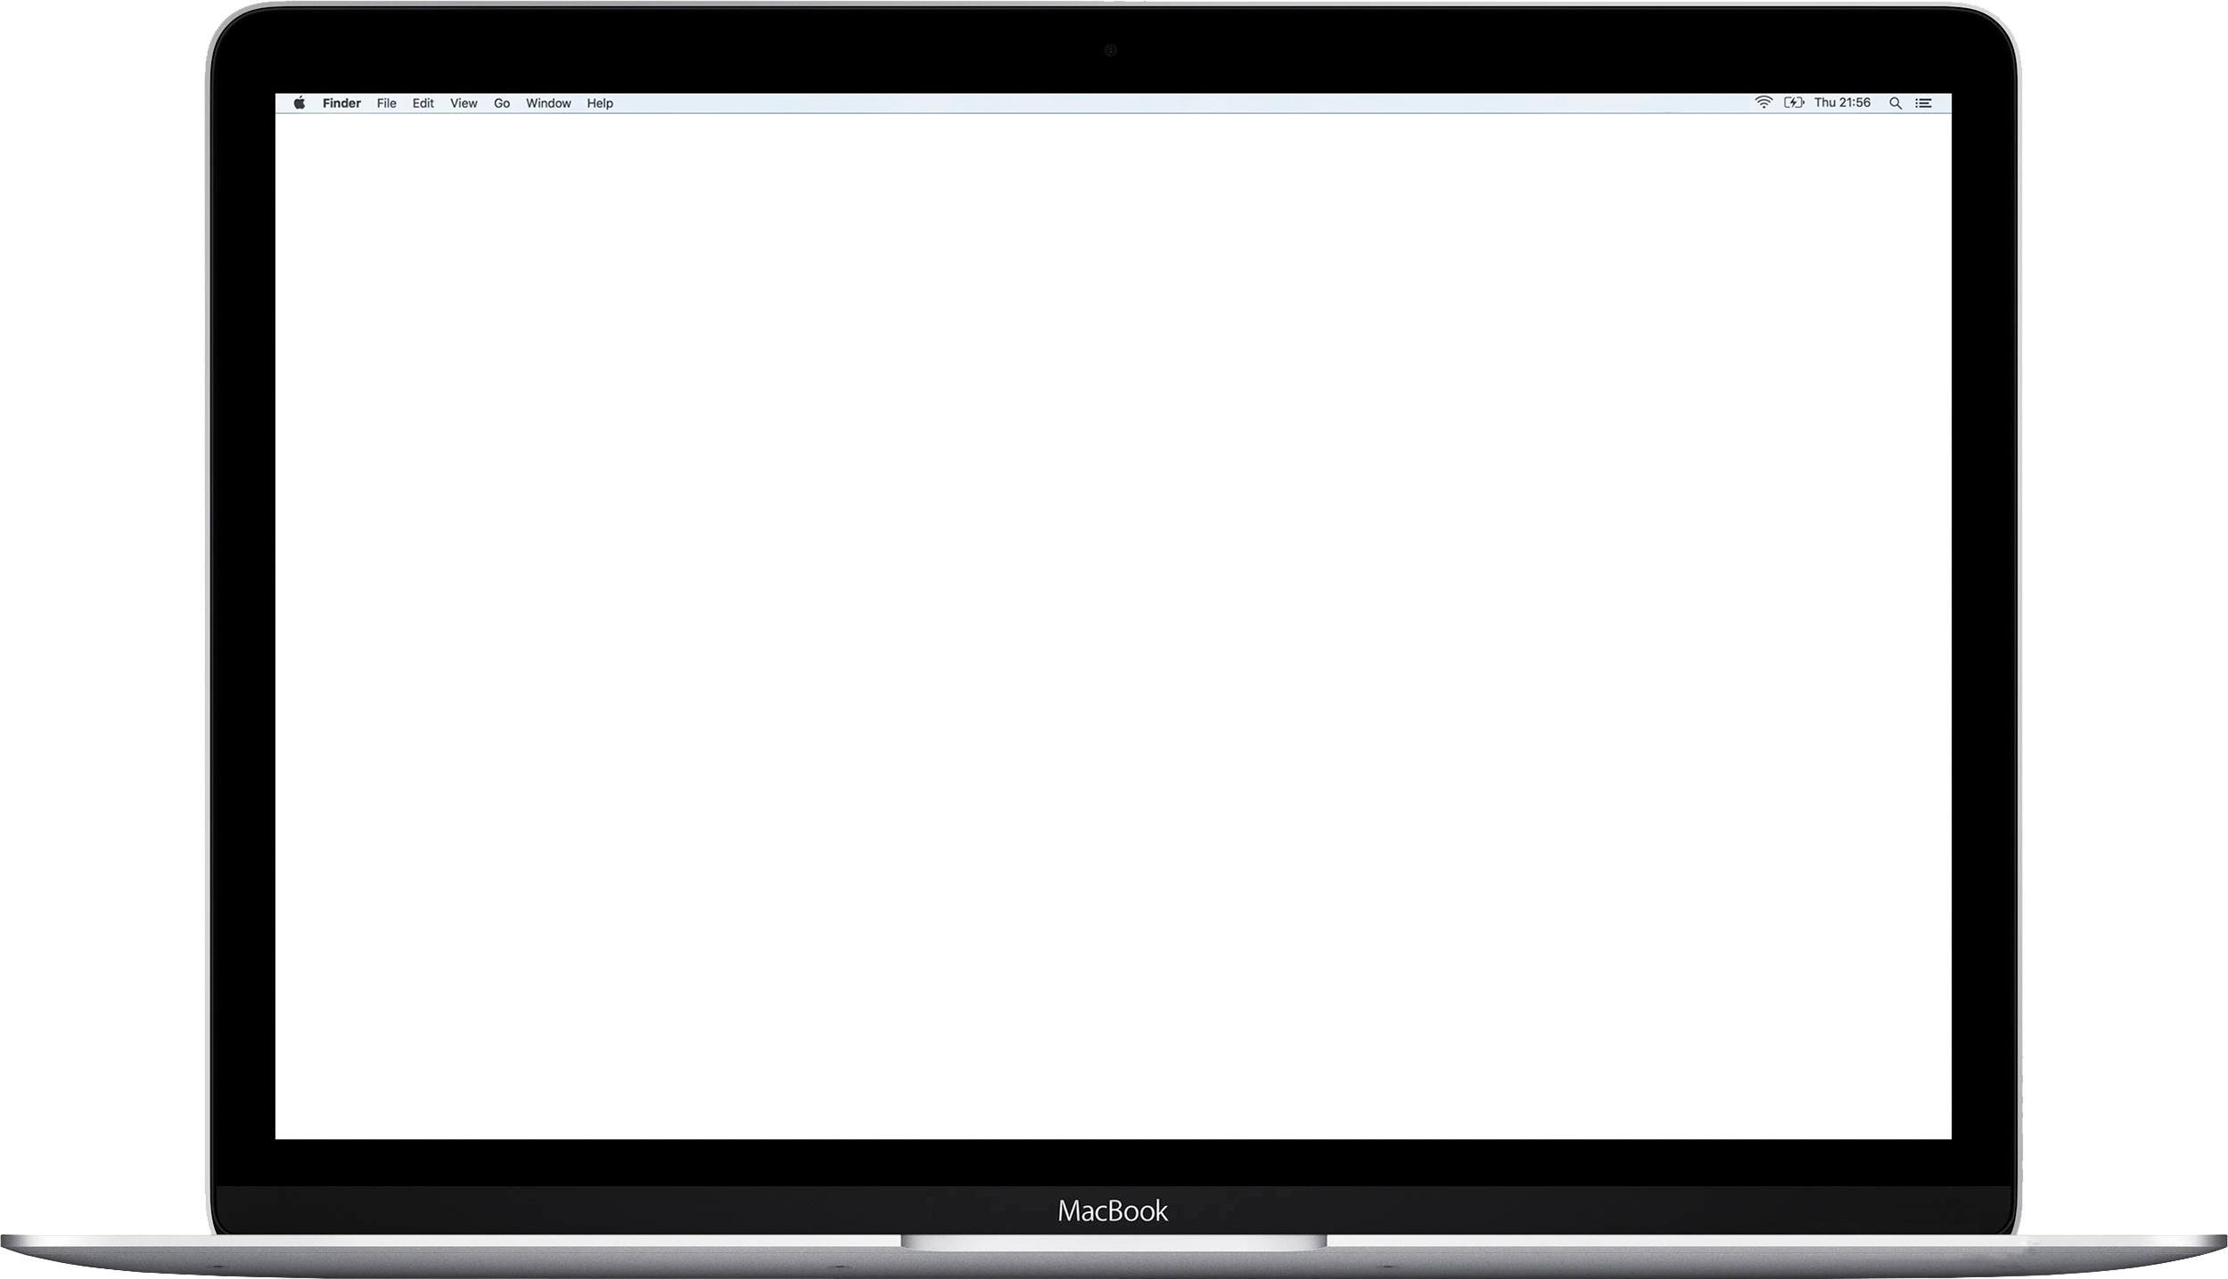





About
About
News
About
Update
Update
Mail
Update
OTA deliver!
PealOS now in beta!
Install updates without reboot!
PealOS 1.0 Beta
You can access OS just joining our chanel!
No Email….
Hi.
No updates now
Apps
Not For Resale
Apps
Bc Beta
iMessage
Apps
GameBar
GameBar
GameBar
Hello, PealStudio
Let’s explore!
Dota 2 is ready,
gotov popku pupsik

Slide 10
News
OTA deliver!
PealOS now in beta!
Install updates without reboot!
You can access OS just joining our chanel!
About
Update
Hi.
Apps
GameBar
Hello, PealStudio
Let’s explore!
Dota 2 is ready,
gotov popku pupsik

Slide 11
News
OTA deliver!
PealOS now in beta!
Install updates without reboot!
You can access OS just joining our chanel!
About
Update
PealOS 1.0 Beta
Apps
#teampeal
GameBar
Hello, PealStudio
Let’s explore!
Dota 2 is ready,
gotov popku pupsik

Slide 12
News
OTA deliver!
PealOS now in beta!
Install updates without reboot!
You can access OS just joining our chanel!
About
Update
No updates now
Apps
Bc Beta
GameBar
Hello, PealStudio
Let’s explore!
Dota 2 is ready,
gotov popku pupsik

Slide 13
News
OTA deliver!
PealOS now in beta!
Install updates without reboot!
You can access OS just joining our chanel!
Mail
No Email….
iMessage
Hello, PealStudio
Let’s explore!
Dota 2 is ready,
gotov popku pupsik

Slide 14
News
OTA deliver!
PealOS now in beta!
Install updates without reboot!
You can access OS just joining our chanel!
Hello, PealStudio
Let’s explore!
Dota 2 is ready,
gotov popku pupsik

Slide 15
About
About
News
About
Update
Update
Mail
Update
OTA deliver!
PealOS now in beta!
Install updates without reboot!
PealOS 1.0 Beta
You can access OS just joining our chanel!
No Email….
Hi.
No updates now
Apps
Not For Resale
Apps
Bc Beta
iMessage
Apps
GameBar
GameBar
GameBar
Hello, PealStudio
Let’s explore!
Dota 2 is ready,
gotov popku pupsik

